Slide 1
SHOP MANAGEMENT SYSTEM
● BY FURKAN PETKAR

Slide 2
INTRODUCTION
A Shop Management System is the heartbeat of modern retail operations. It is used to maintain shop records. It tracks the records of the number of products in the shop, how many products are issued, or how many products have been returned or sold etc.

Slide 3
●Customer
●Product
P_id
P_name
C_id
Name
Address
Phone_number
Amount
Email
●Stock
P_id
Quantity
●Order_detail
Ord_id
P_id
Quantity

Slide 4
DATABASE DESIGN
Database :- Shop Management System
Tables;
● Customer
● Product
● Order_detail
● Stock

Slide 5
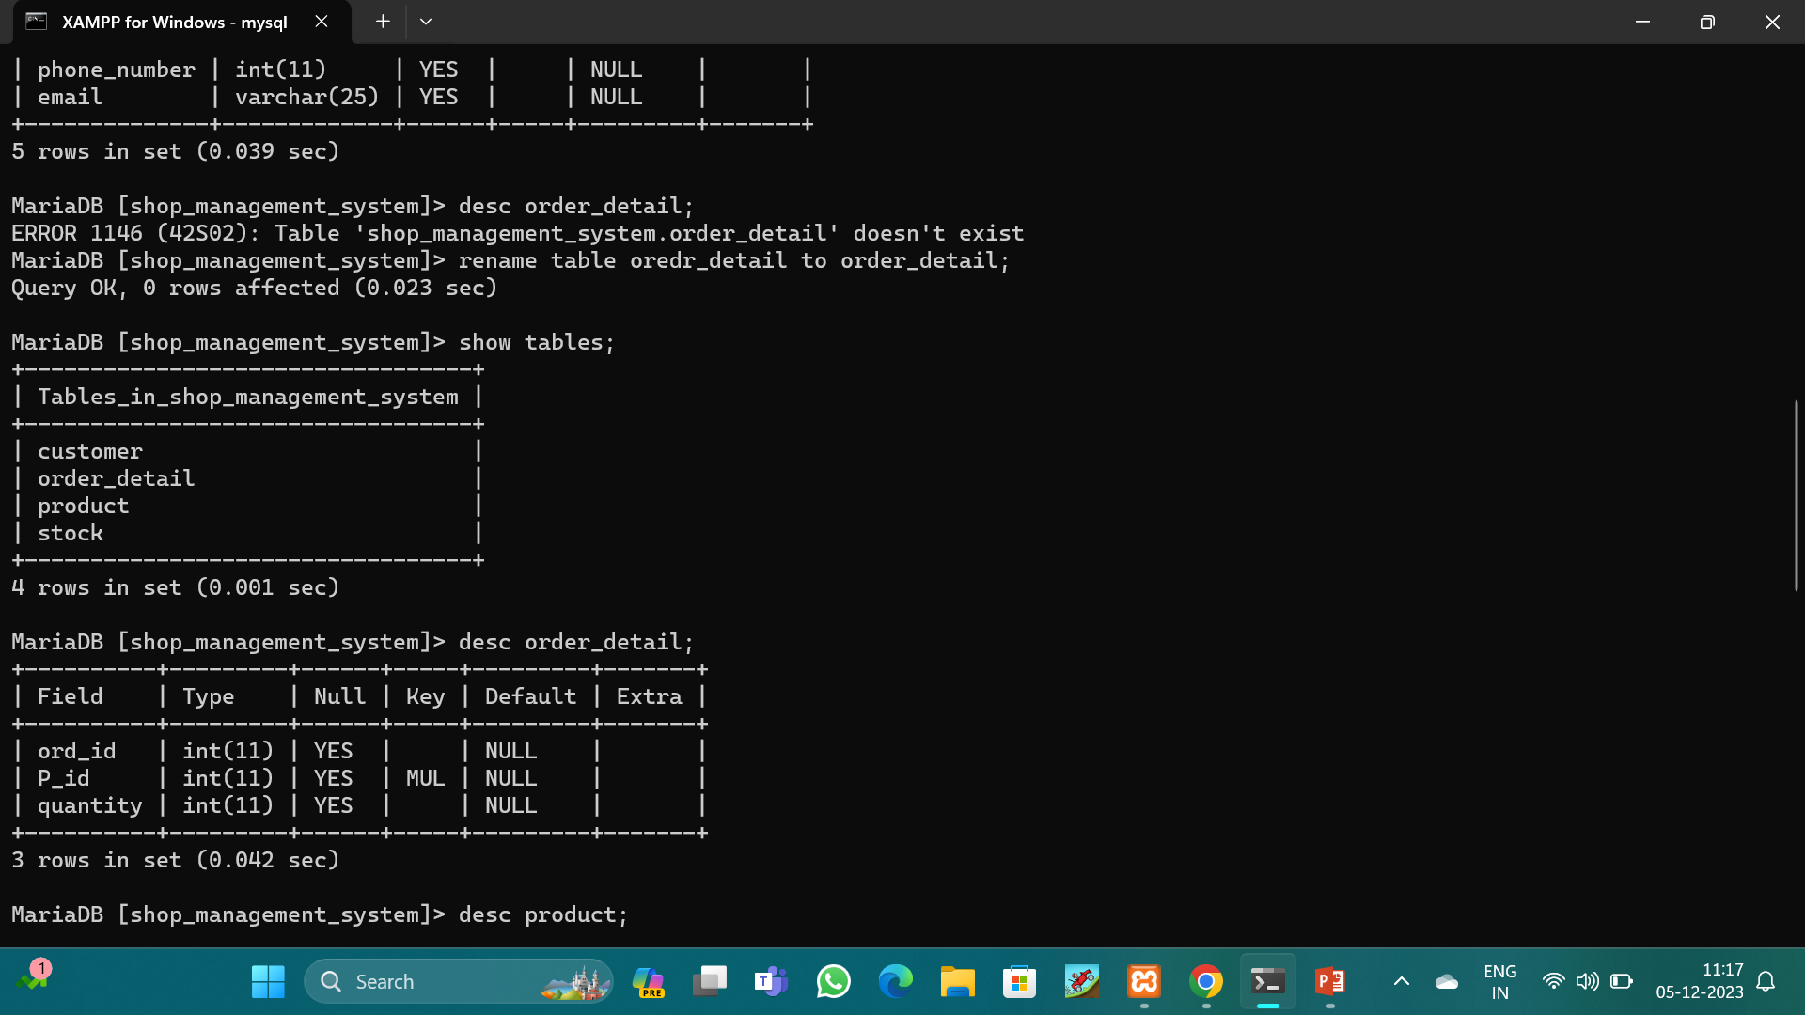
SYNTAX : SHOW TABLES;

Slide 6
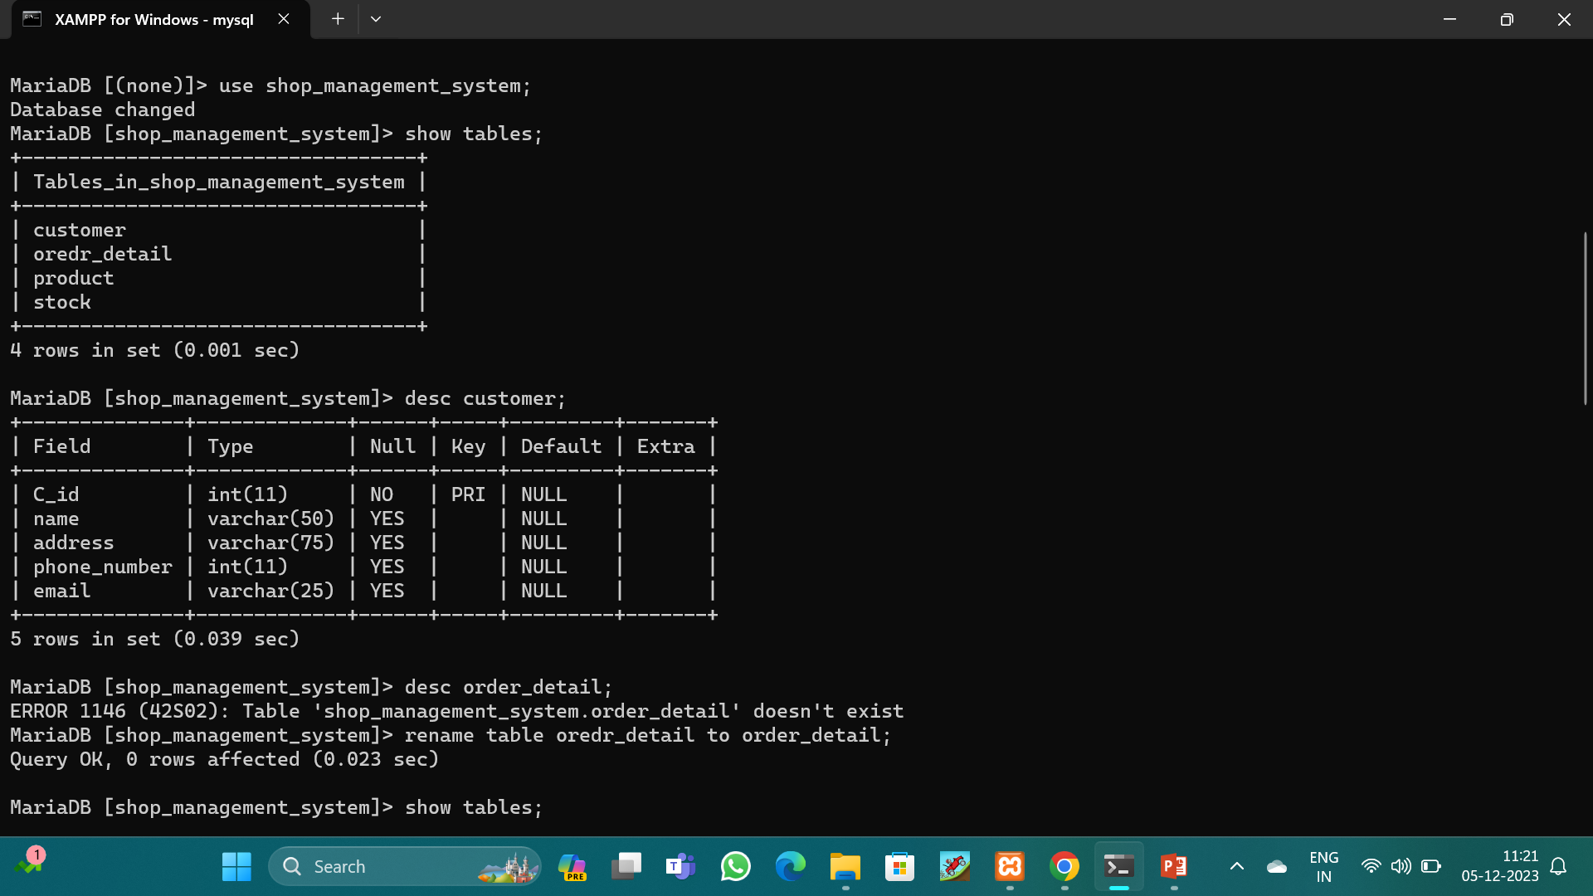
I WANT TO SEE STRUCTURE OF THE TABLES; SYNTAX : DESC CUSTOMER;

Slide 7
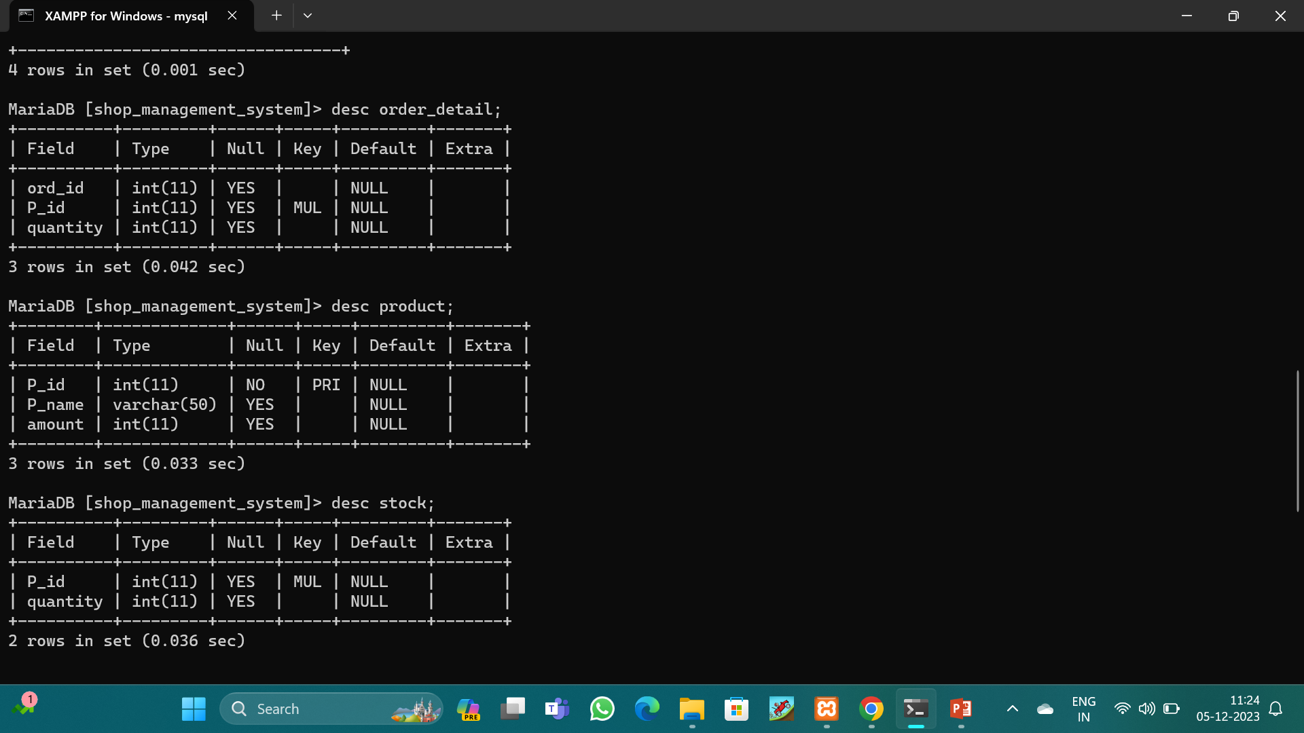
SYNTAX : DESC PRODUCT;

Slide 8
SYNTAX : DESC ORDER_DETAIL;

Slide 9
SYNTAX : DESC STOCK;

Slide 10
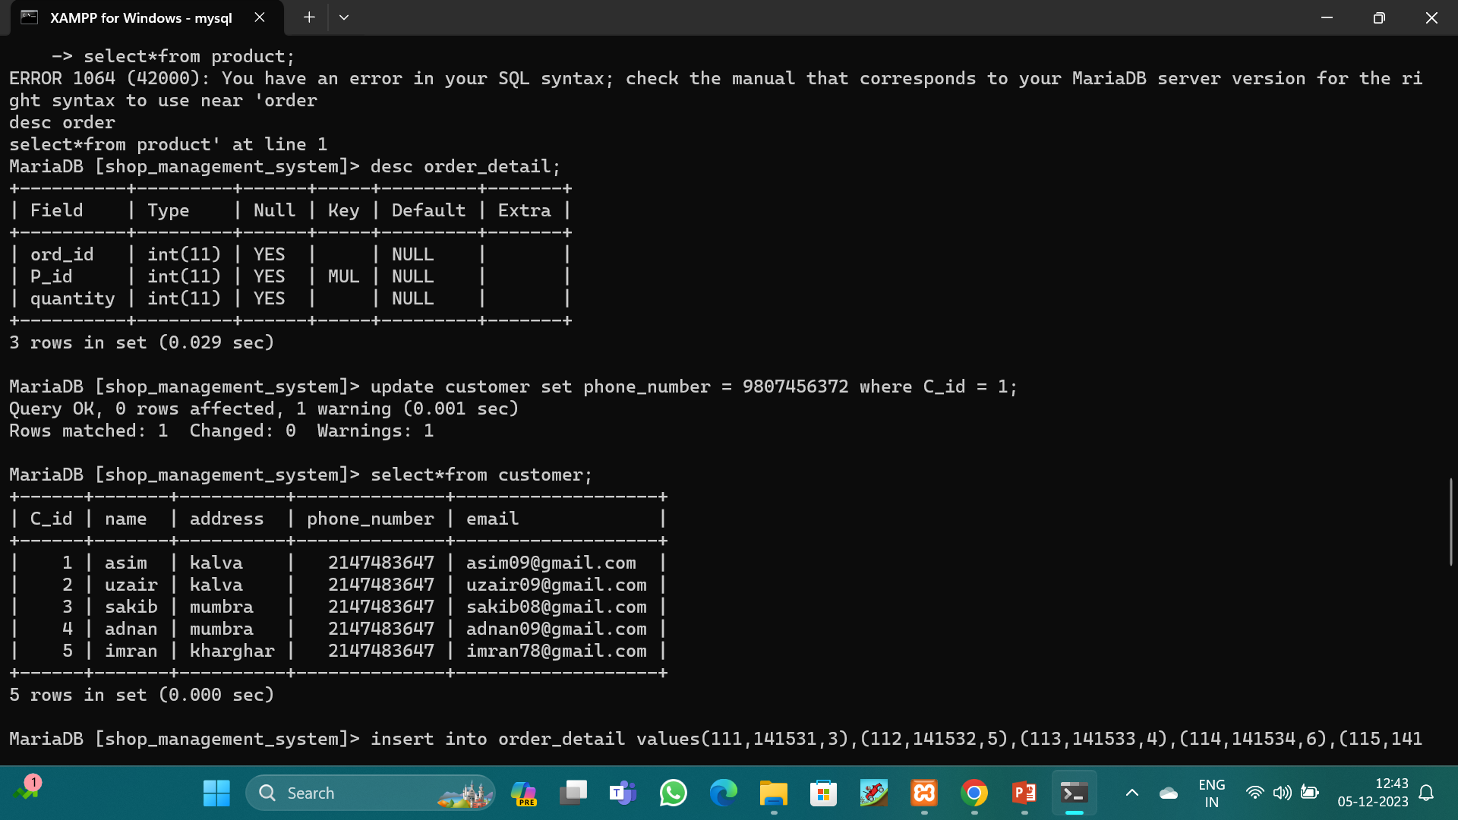
I want to see detail of customer table SYNTAX : SELECT*FROM CUSTOMER;

Slide 11
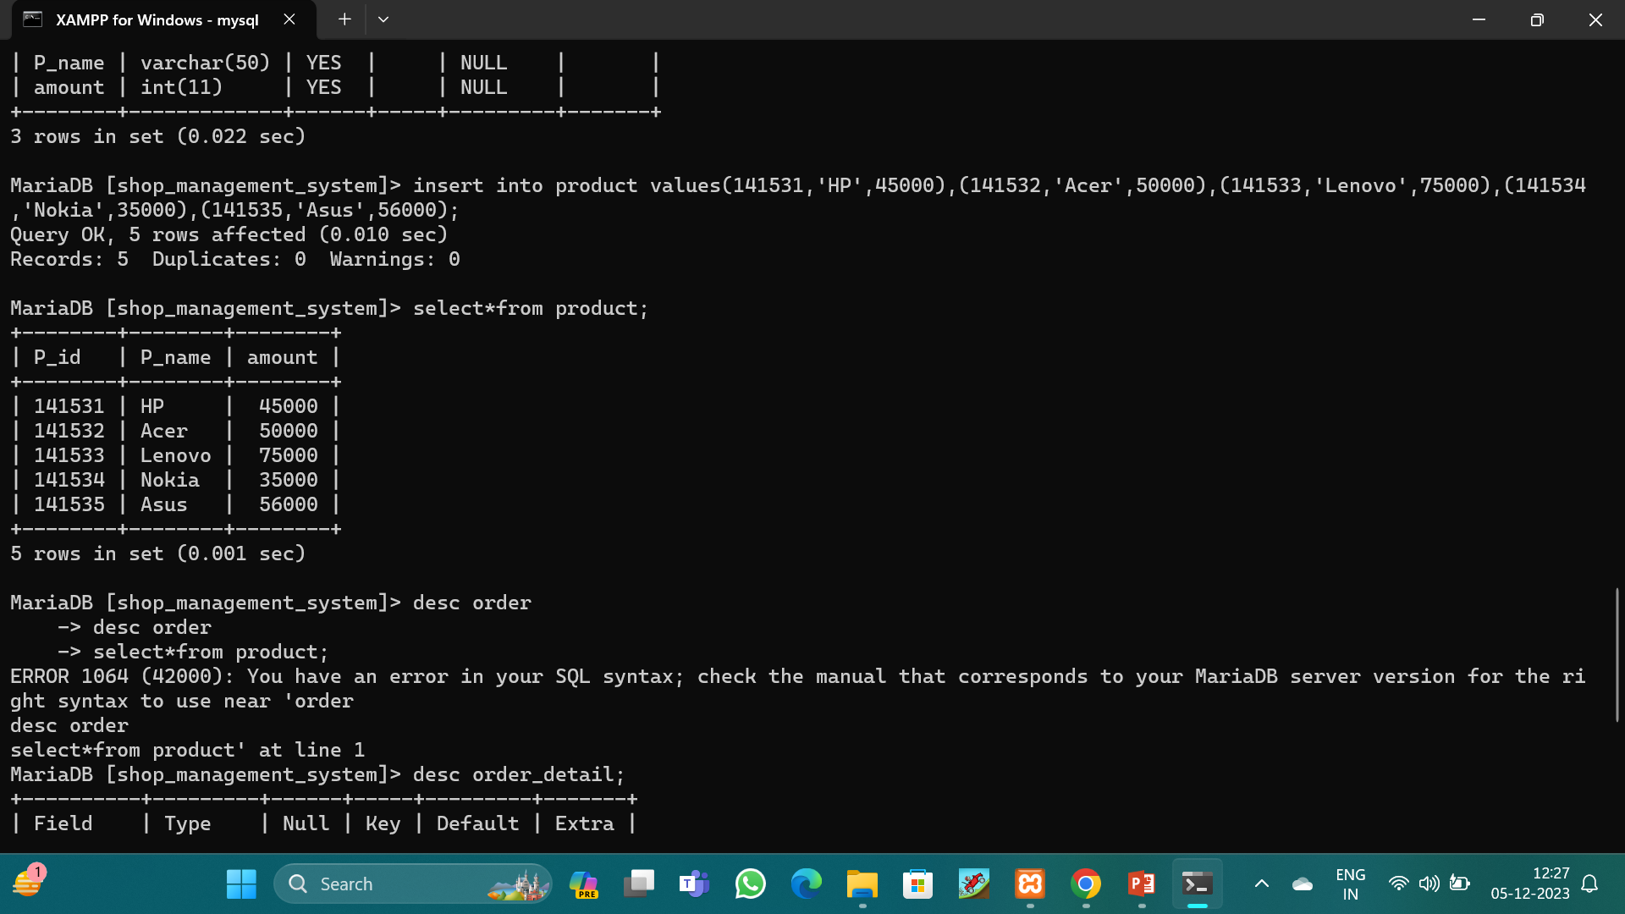
I want to see detail of product table SYNTAX : SELECT*FROM PRODUCT;

Slide 12
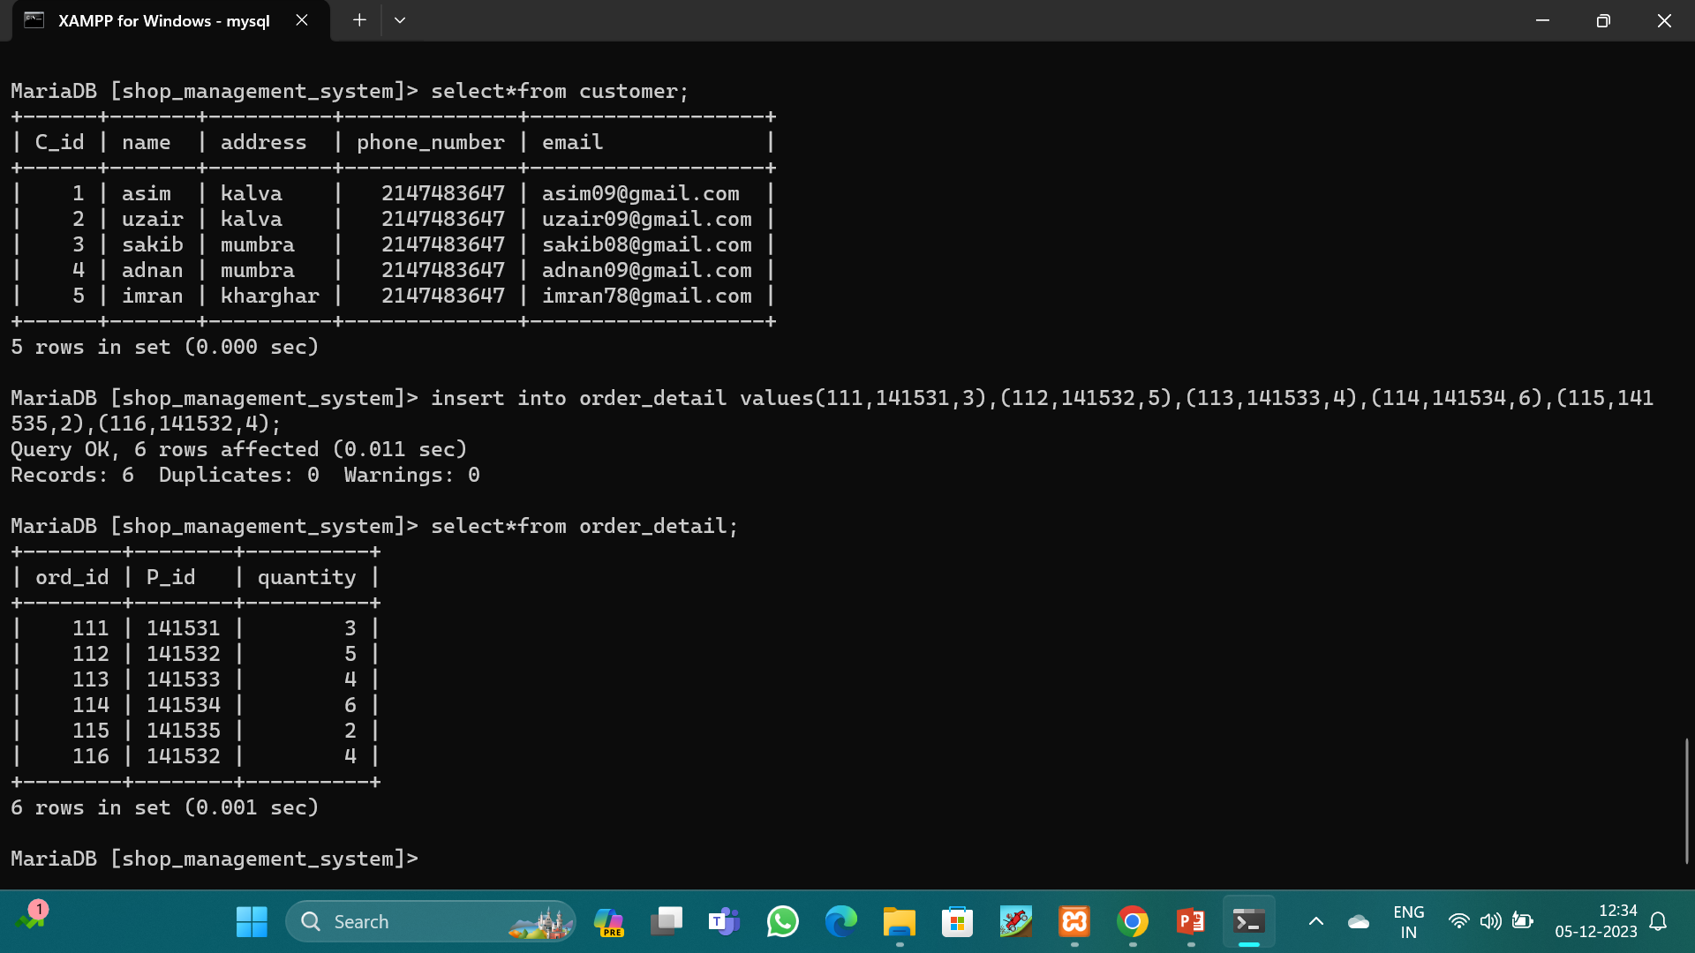
I want to see detail of order_detail table SYNTAX : SELECT*FROM ORDER_DETAIL;

Slide 13
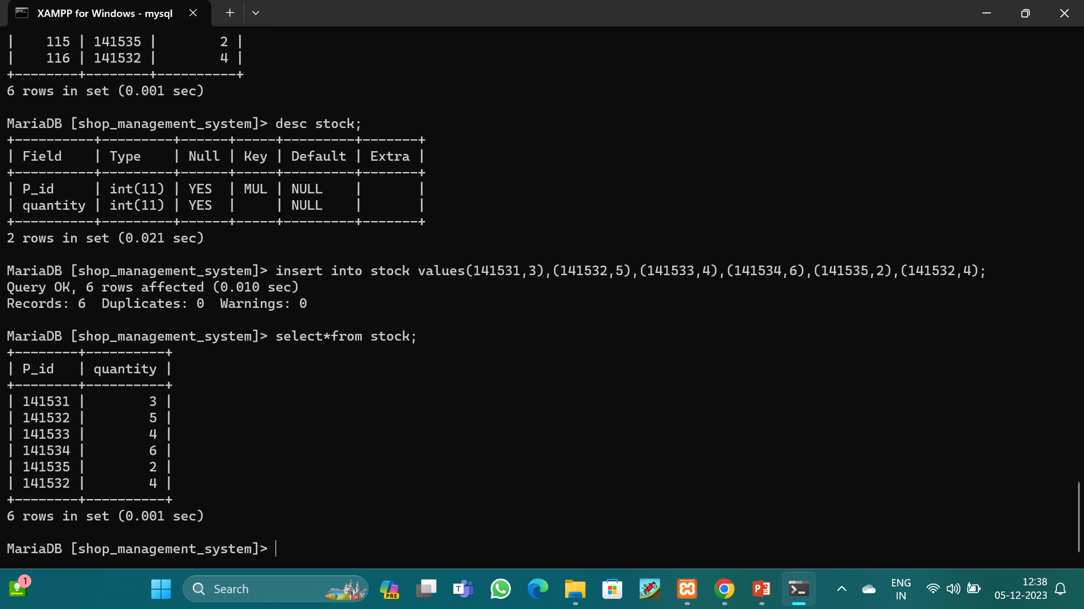
I want to see detail of stock table SYNTAX : SELECT*FROM STOCK;

Slide 14
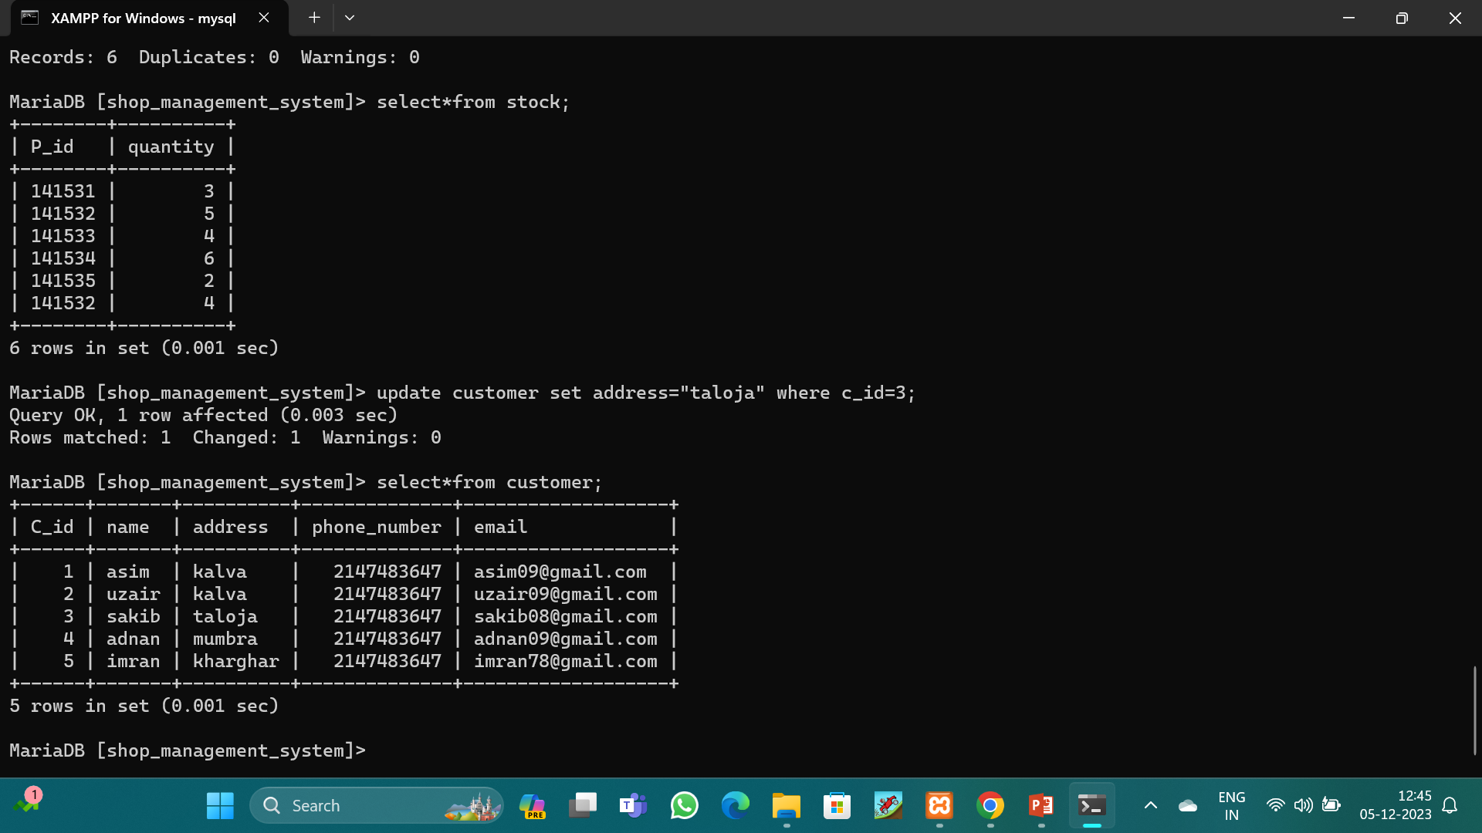
Suppose I want to update my data in table. SYNTAX : UPDATE CUSTOMER SET ADDRESS=“TALOJA” WHERE C_ID=3;

Slide 15
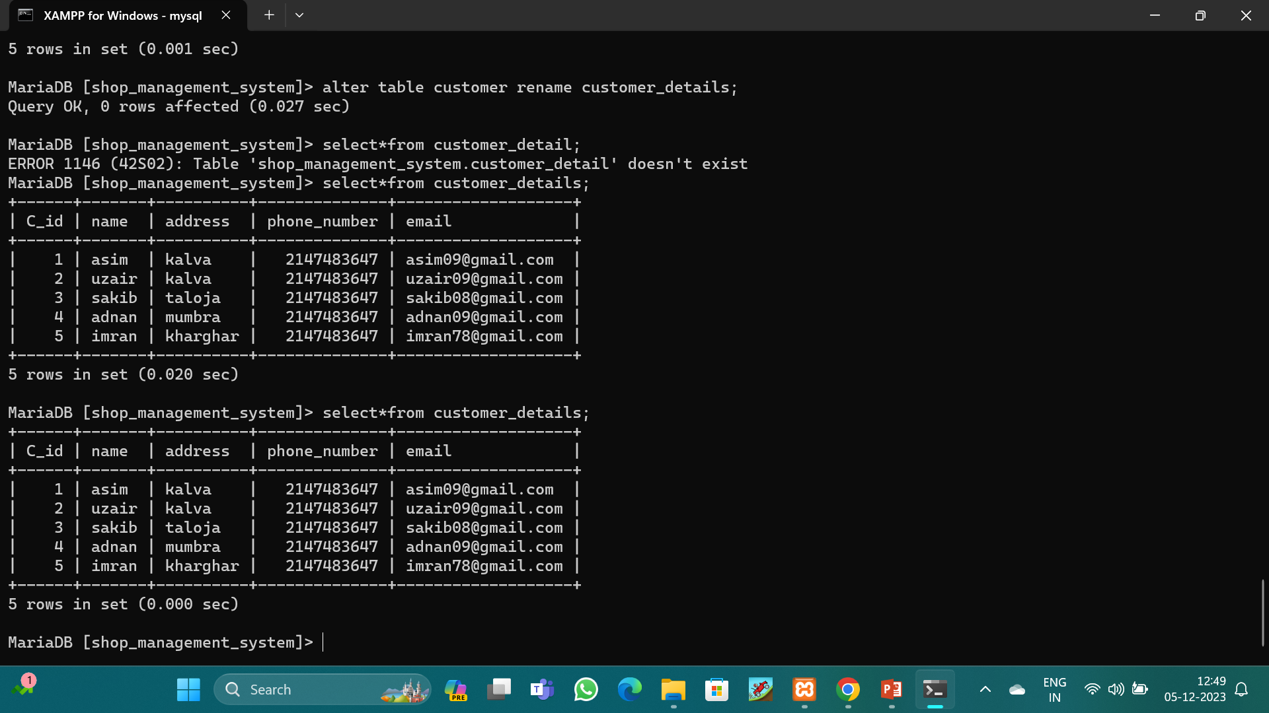
I want to change the name of the table. SYNTAX : ALTER TABLE CUSTOMER RENAME CUSTOMER_DETAILS;

Slide 16
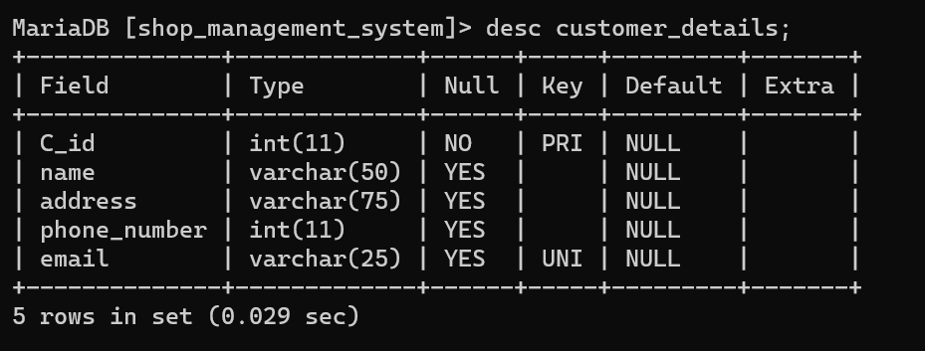
I want to add unique key in the column SYNTAX : ALTER TABLE CUSTOMER_DETAILS ADD UNIQUE KEY (PHONE_NUMBER);

Slide 17
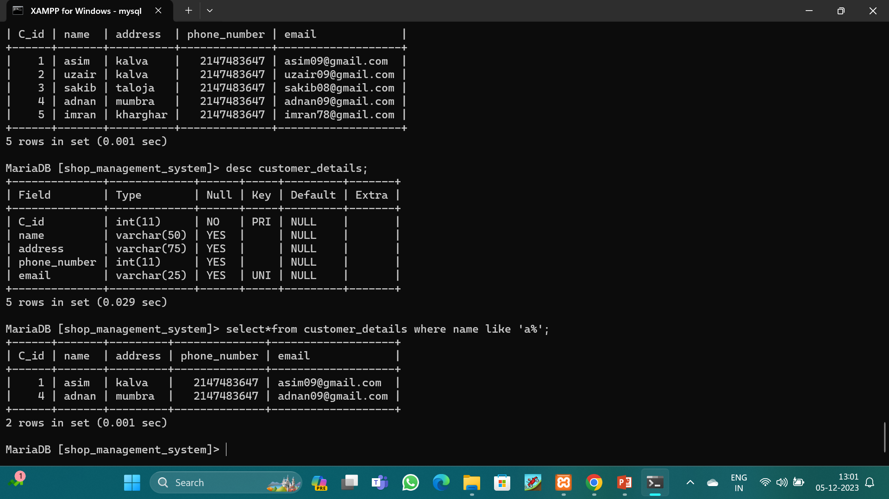
I want some specific data from the table. SYNTAX : SELECT*FROM CUSTOMER_DETAILS WHERE NAME LIKE ‘A%’;

Slide 18
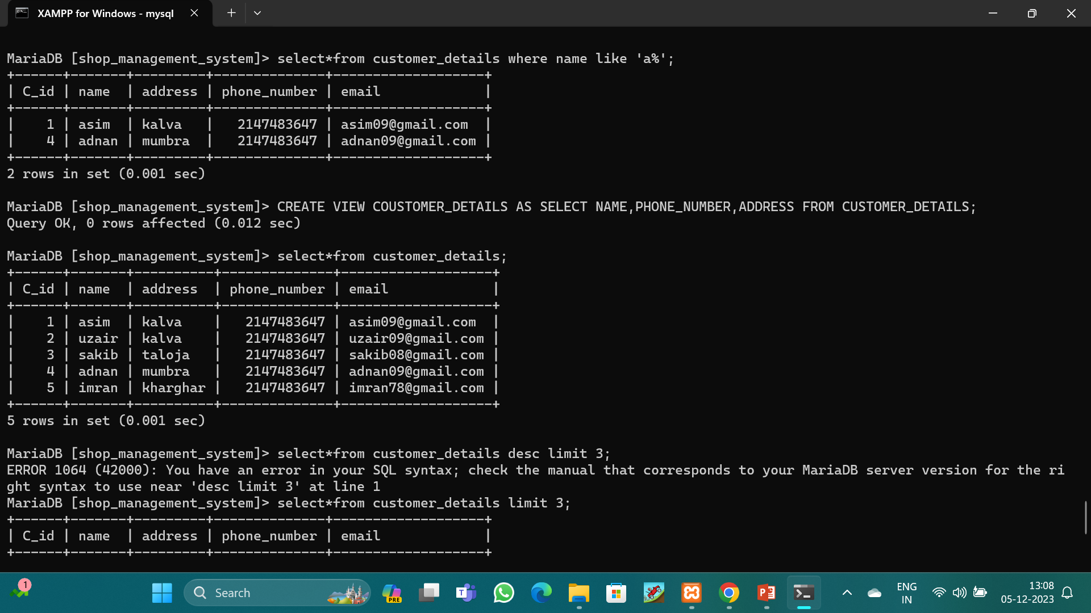
I want to hide some column. SYNTAX : CREATE VIEW COUSTOMER_DETAILS AS SELECT NAME,PHONE_NUMBER,ADDRESS FROM CUSTOMER_DETAILS;

Slide 19
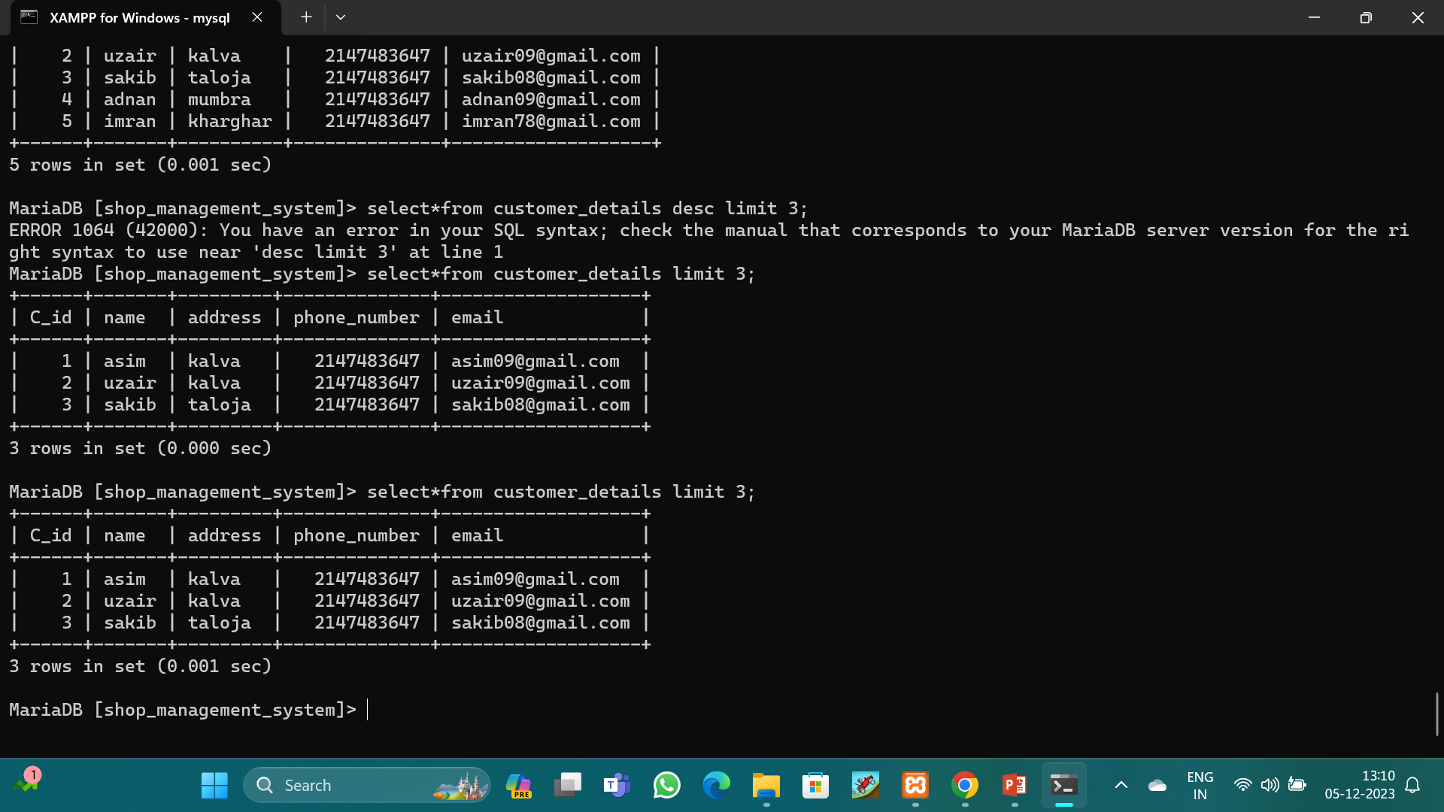
I want fetch the data of the first 3 names. SYNTAX : SELECT*FROM CUSTOMER_DETAILS LIMIT 3;

Slide 20
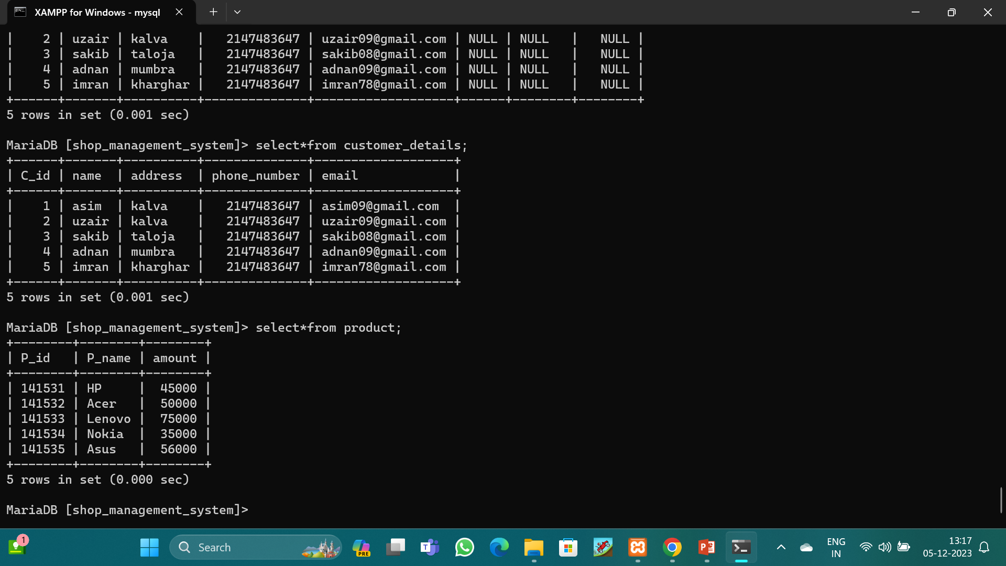
I want to the data of customer_details and product table. SYNTAX : SELECT*FROM CUSTOMER_DETAILS LEFT JOIN PRODUCT ON CUSTOMER_DETAILS. C_ID=PRODUCT.P__ID;

Slide 21
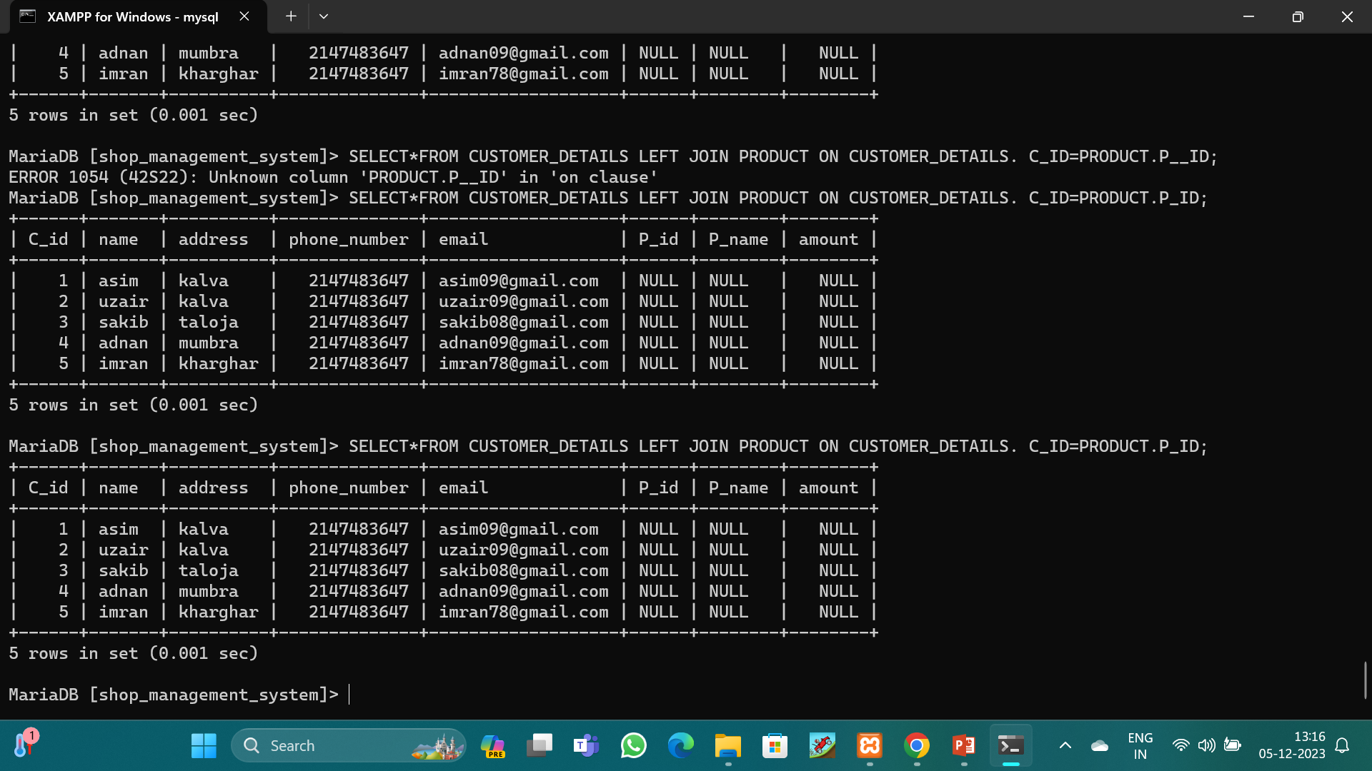
After using left join.

Slide 22
CONCLUSION
Through this project I have gained more experience in SQL database design query optimization and data manipulation this project not only improve my technical skills but also provide practical understanding.

Slide 23
Thank You

